Slide 1

Sample template for reference
Pneumonia diagnosis assistance system
MAIT Delhi_Curosity

Slide 2
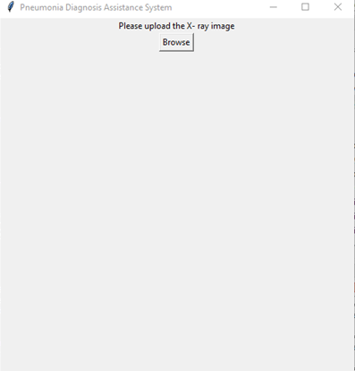
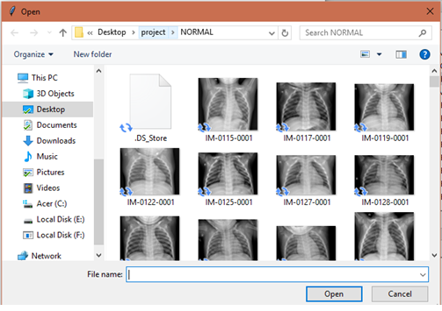
Executing the System
Click on the Browse button to upload
Image of X-ray.

Slide 3
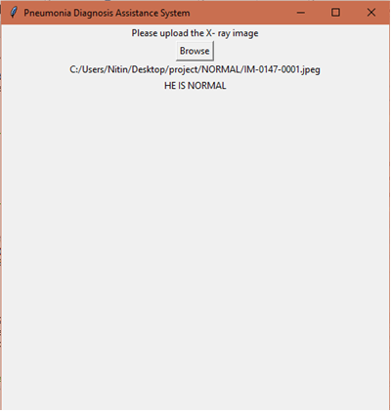

Executing the System
Result in case of healthy patient.
Result in case of pneumonia.

Slide 4
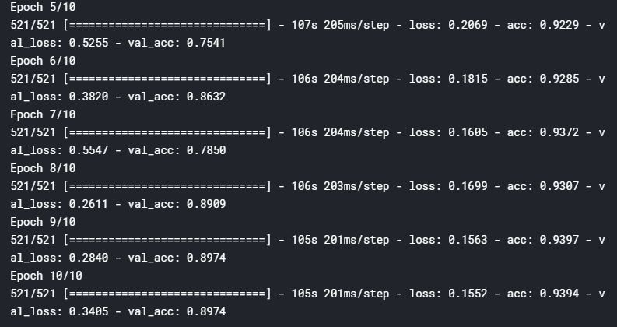
Executing the System
Accuracy of the Pneumonia
Diagnosis Assistance System

Slide 5
Access to dataset :
To download the dataset visit :
https://drive.google.com/open?id=1i-fqvWeu0N1ZNdVAxNGnJXWu20GL-T_w
To clone or download visit GitHub at:
https://github.com/nitinssj3/PNEUMONIA_DETECTION

Slide 6

Thank You!
MAIT Delhi_Curosity

